Slide 1
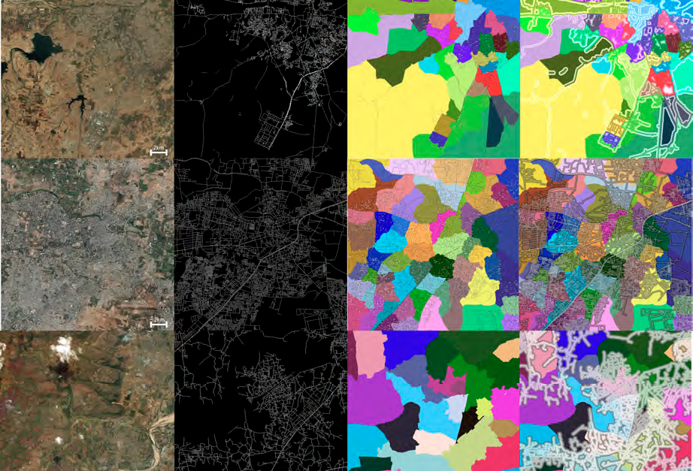
Street Address, Satellite Imagery, and Generative AI
MUSA 6500 Deep Learning with Python
University of Pennsylvania
February 18, 2025
Jun, Youngsang
Demir et al. (2018), Generative Street Addresses from Satellite Imagery
Notes:
Good morning. I am Youngsang Jun. Today I would like to introduce a study about one of the applications of remote sensing in urban planning, specifically regarding street addressing, which is one of my research interests.

Slide 2
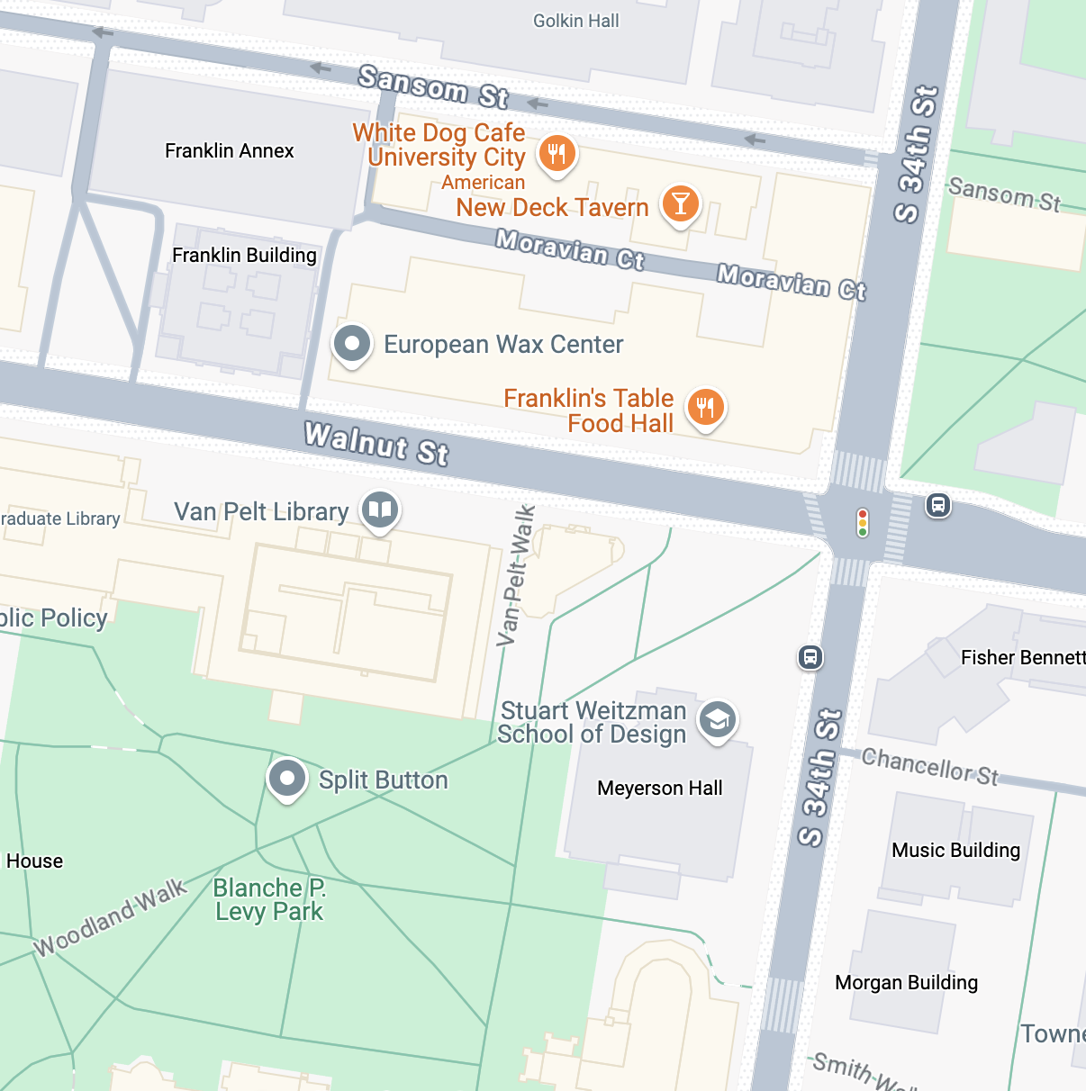
What Do You Think an Address is?
“Structured information that allows the unambiguous determination of an object for purposes of identification and location” (ISO 19160-1:2015)
Building Name: Meyerson Hall, University of Pennsylvania
Street Address: 210 South 34th Street, Philadelphia, PA
Latitude and Longitude: 39° 57’ 8” N 75° 11’ 34” W
What3words Geocoding: ///inform.glue.paid
Notes:
Before we get into it, I would like to ask you a question. What do you think an address is? Int’l Standard Org. defines address as “Structured information that allows the unambiguous determination of an object for purposes of identification and location.” The building we are in now is Meyerson Hall, and its address is shown here. With this address, we can identify this building with others as well as predict its location with this structured street and building numbering system on the next slide. We can identify and predict location using building name, latitude and longitude, or automatic geocoding systems like what3words, but it is lack of road topology coherence, and it is also machine-friendly, far from human-friendly navigation.

Slide 3
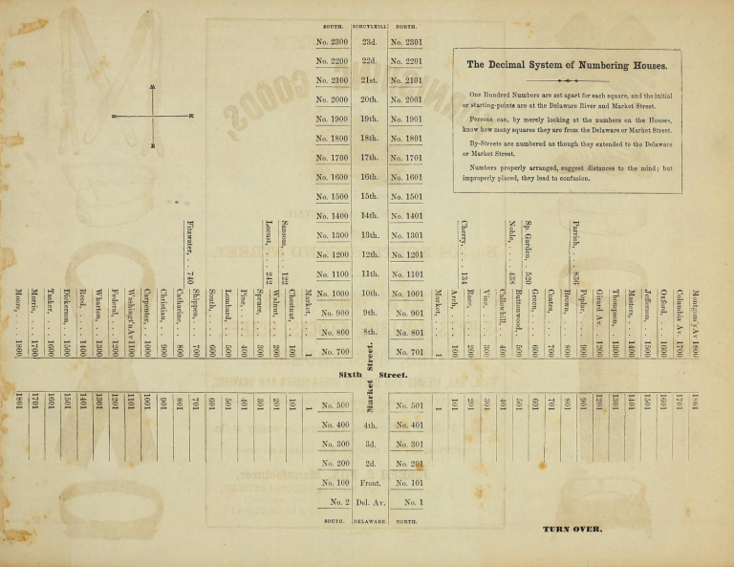
210 South 34th Street
https://philadelphiaencyclopedia.org/essays/street-numbering/
Notes:
Here is the decimal system of numbering houses in Philadelphia, which is invented by John Mascher in 1824. The north is the right side of the screen, and in Philadelphia, we know north and south are divided by Market Street. We also know the streets are numbered from the Delaware River, which is at the bottom of the screen. With these principles, we can easily predict our current location as well as our destination. So if someone asks me “Hey, do addresses need to be structured with street name and building number?”, then I would say “It is one of the options, but it is still the best way to predict the location of the destination by using adjacent street names and distances from my location.”

Slide 4
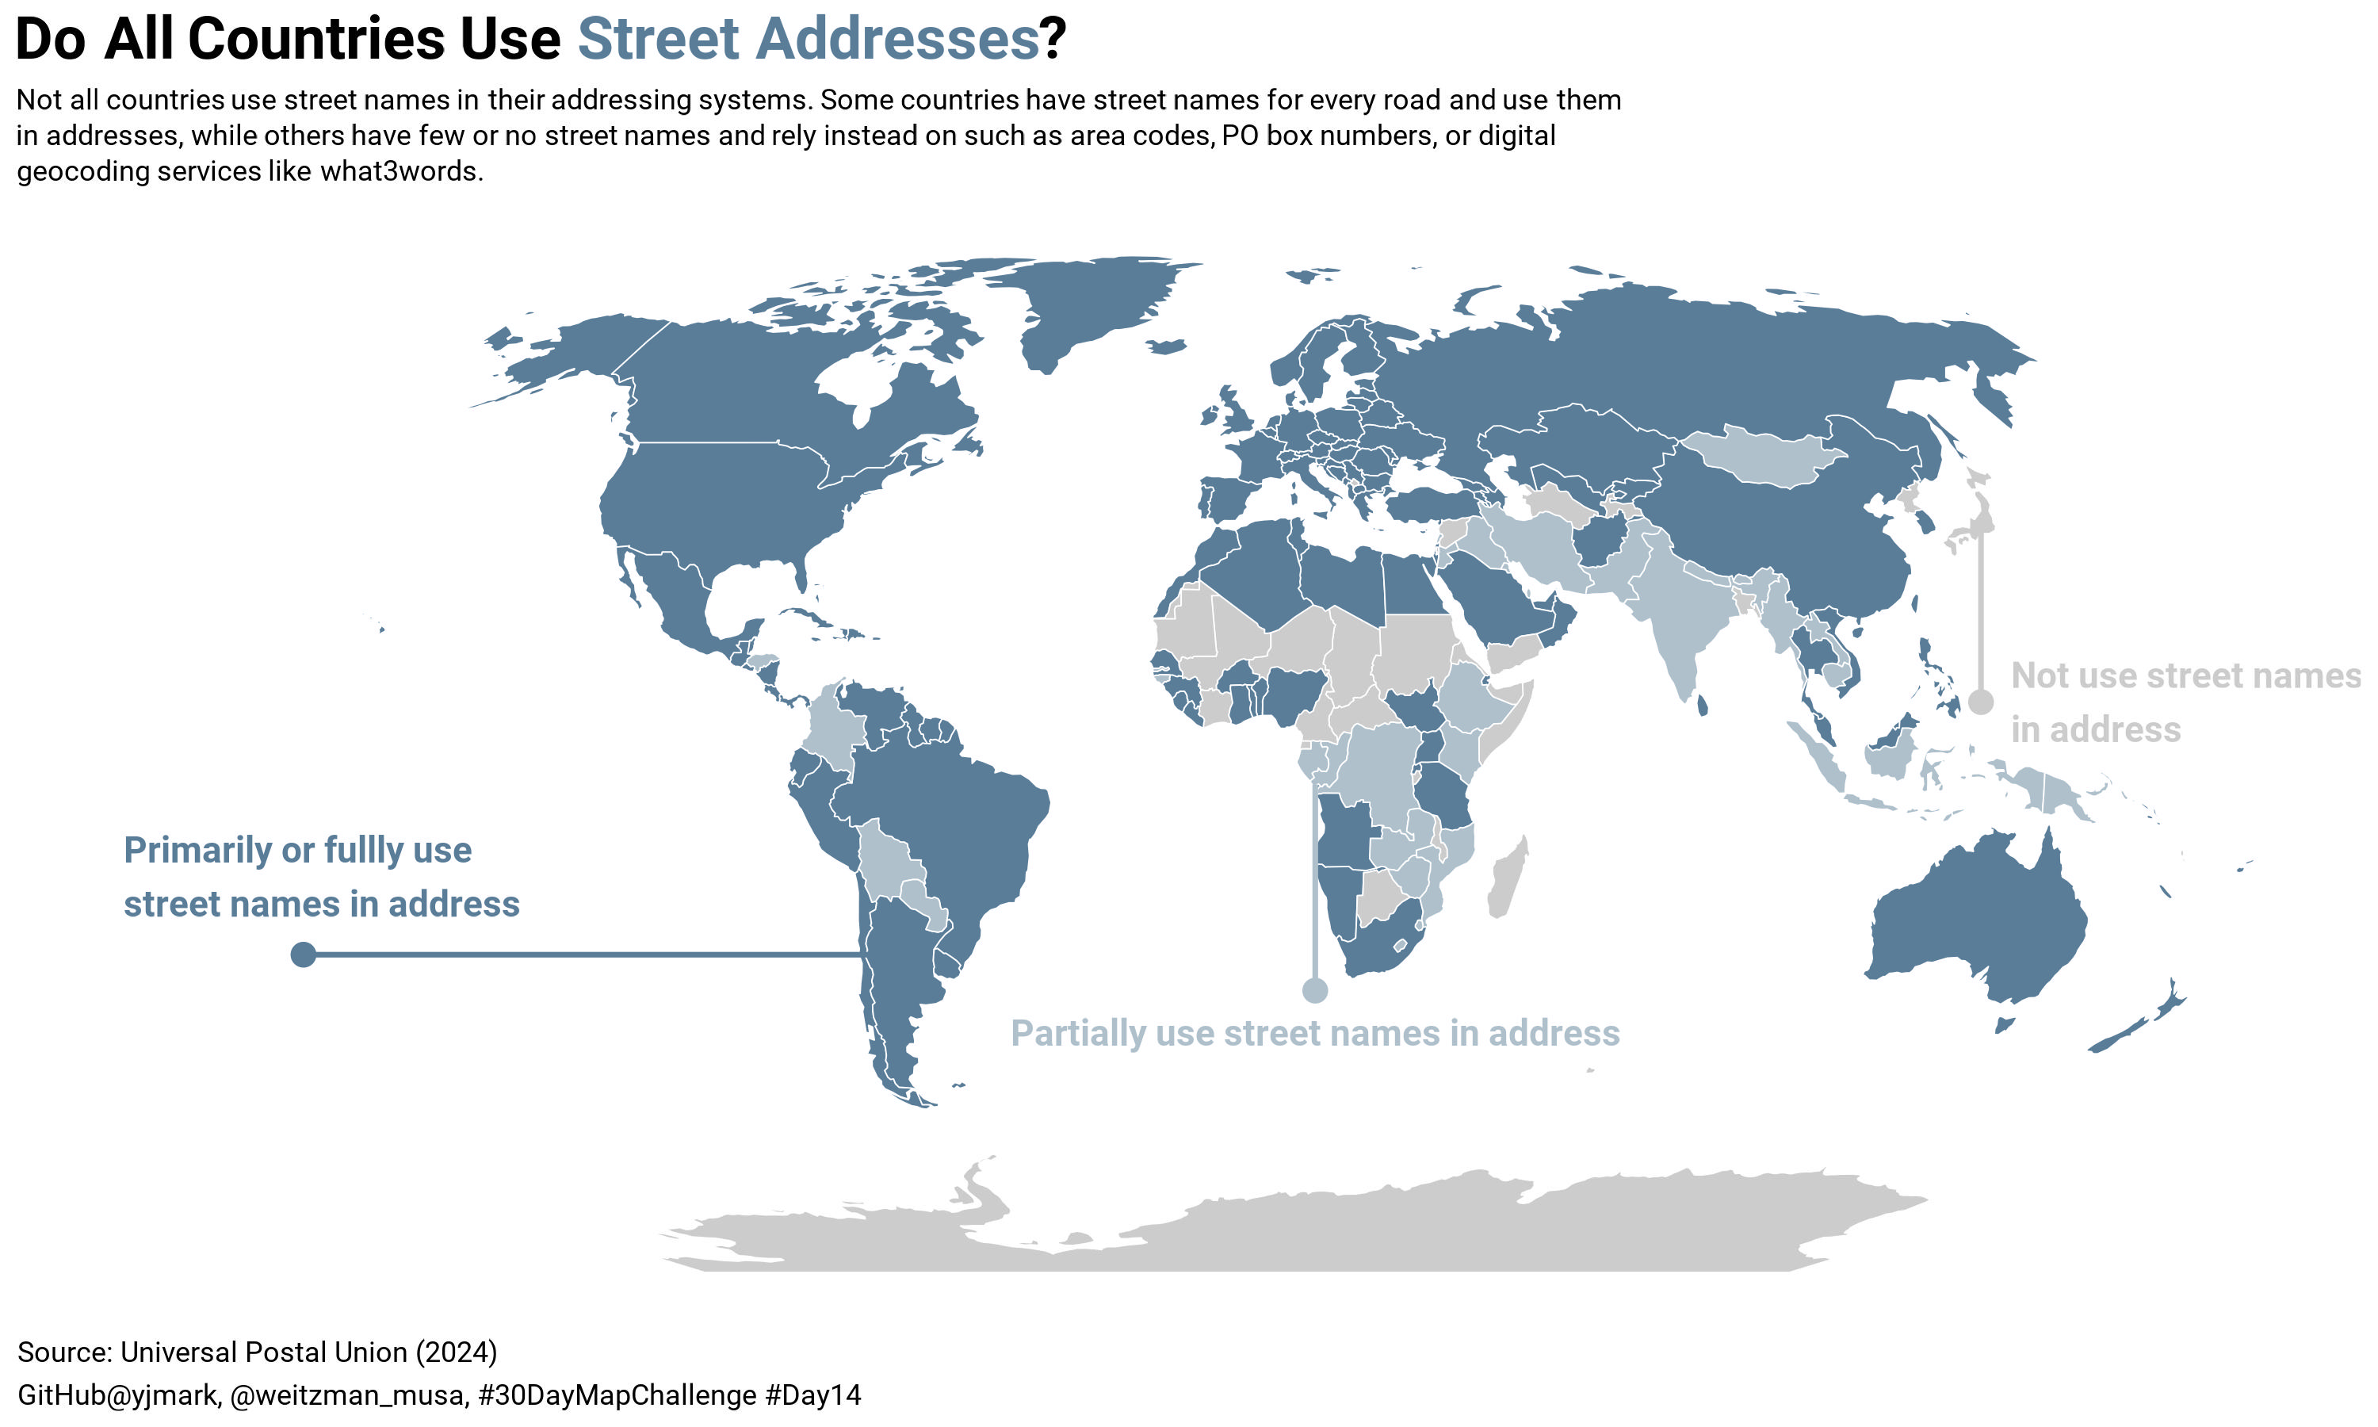
Notes:
Then do all countries use street addresses? It is known that 75% of the world’s roads lack proper street addressing. Getting data from the Universal Postal Union, I made this map to visualize how widely street addressing has spread worldwide. Not all countries use street names in their addressing systems. Some countries have street names for every road and use them in addresses, while others have few or no street names and rely instead on such as area codes, PO box numbers, or digital geocoding services.

Slide 5
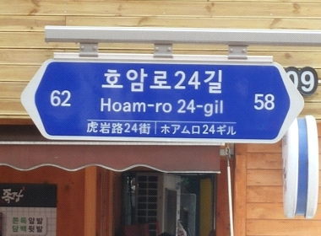
Street Address of Republic of Korea
1910-2013: No street addresses existed, but land-lot numbers and building names were used as addresses, which originated from the Japanese colonial period (1910-1945)
1996-2006: Prepared introduction of Road Name Address, and implemented pilot projects in several cities
2007: Road Name Address Law Legislated
2008-2011: Named every road, and gave road name address to every building in the whole country
2014-now: Road name address became official address of every building in the whole country
Local authorities are responsible for managing addresses with urban change
Can we automate addressing using satellite images and generative AI?
Notes:
The reason I became interested in street addressing is that Korea recently implemented a nationwide street address system. Before 2007, Korea did not have a legal framework for street addresses, and people relied on land-lot numbers, which were assigned sequentially. Since land-lot numbers do not provide any indication of location, people depended on building names instead to predict their location. However, since 2014, all buildings in Korea have been assigned street addresses, and now, local authorities are responsible for updating them as urban areas change. And I finally found a study on the automation of addressing using satellite images and generative AI, the title of which is shown on the next slide.

Slide 6
Demir et al. (2018), Generative Street Addresses from Satellite Imagery
Notes:
Now I will move on to Demir’s study.

Slide 7
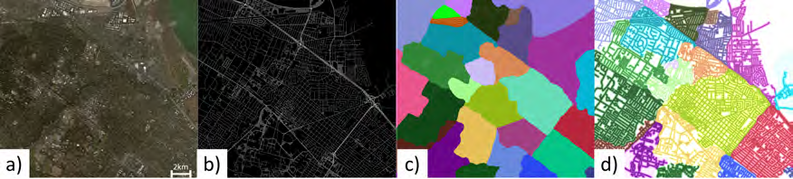
Objective of Demir et al. (2018) Study:
Develop an automatic generative algorithm to create street addresses using satellite imagery and AI
(a) satellite imagery; (b) prediction of roads; (c) breaks roads into regions; (d) obtains addresses.
Demir et al. (2018), Generative Street Addresses from Satellite Imagery
Notes:
The Demir’s study aims to develop an automatic generative algorithm to create street addresses using satellite imagery and AI. The authors’ approach starts with (a) satellite imagery; predicts (b) roads; breaks them into (c) regions; to obtain (d) addresses.

Slide 8
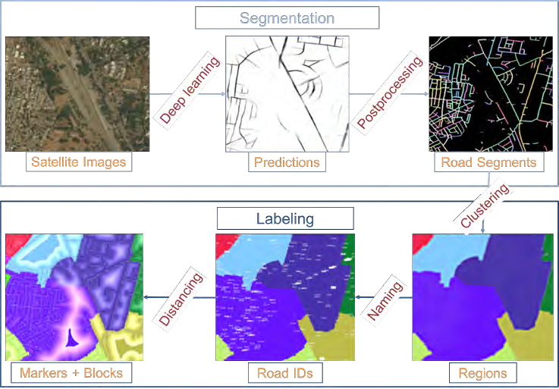
Pipeline of Generative Addressing System
(1) Road prediction from satellite images using deep learning
Input data
Digital Globe satellite images
0.5 m resolution / 3 channel / 19 K * 19 K size
OSM, open datasets, and land cover classification model
To query the city, state, and country boundary information
Existing street geometry and names
To augment the road predictions
GIS experts create binary road masks, by manually labeling each pixel as a road or not road
Demir et al. (2018), Generative Street Addresses from Satellite Imagery
Notes:
Here is the system pipeline. The first step is creating road prediction model from satellite images. To do this, the author used Digital globe satellite images with 0.5m resolution, with additional existing datasets to enhance the precision. Also, GIS experts create binary road masks, by manually labeling each pixel as a road or not road.

Slide 9
Pipeline of Generative Addressing System (cont.)
(1) Road prediction from satellite images using deep learning (cont.)
NN Model
SegNet, VGG, U-Net, ResNet
Output data
Binary road prediction images
Demir et al. (2018), Generative Street Addresses from Satellite Imagery
Notes:
The authors used some state-of-the-art neural network model and compared the performance. The output data is binary road prediction images.

Slide 10
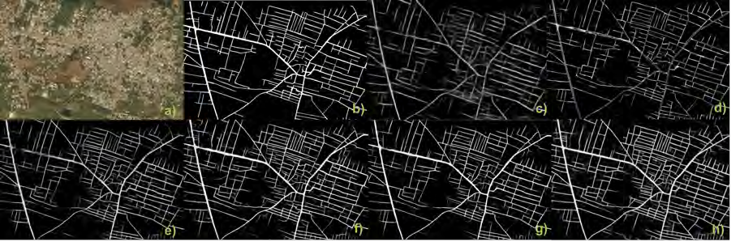
NN Model Comparison
Model Precision (=TP/(TP+FP) Recall (=TP/(TP+FN))
SegNet 72.6% 57.2% (stable)
DeepLab75.4% 75.9% (overfitting)
An example (a) satellite image and (b) ground truth; and road predictions using (c) VGG; (d) U-Net; (e) ResNet50; (f) ResNet101; (g) SegNet; and (h) DeepLab.
Demir et al. (2018), Generative Street Addresses from Satellite Imagery
Notes:
Among the NN models, SegNet model’s precision and recall was the best. DeepLab has also good precision and recall, but it caused overfitting.

Slide 11
Pipeline of Generative Addressing System (cont.)
(2) Postprocessing
Creates weighted pixels based on confidence
Thresholding
Merging broken connections (OSM)
(3) Identifying and segmenting regions
(4) Assigning structured addresses based on road topology
Demir et al. (2018), Generative Street Addresses from Satellite Imagery
Notes:
The second step is postprocessing. With the road prediction images gained, they created weighted pixels based on confidence, and conducted thresholding, and merging broken connections. The third step is identifying and segmenting regions. The last step is assigning structured addresses based on road topology.

Slide 12
Real-World Applications
Tested in both developed and developing areas
* The authors did not mention the specific country or city.
Results
The model was able to learn 90.5% of roads in unmapped suburban areas, 80% in cities (avg)
80% of roads in populated areas successfully addressed
Benefits of the system
Provides hierarchical, intuitive, and scalable addressing automatically
Can generate addresses in previously unmapped areas
Notes:
The author tested in both developed and developing areas, though they did not mention the specific country or city. Overall, the model was able to learn 90.5% of roads in unmapped suburban areas, and 80% in cities, on average. Finally, 80% of the roads in populated areas were successfully addressed. Through this system, we are expected to address automatically, even in previously unmapped areas, such as developing countries that have no nationwide addressing system.

Slide 13
Future Improvements
Challenges
Handling 3D road structures (e.g., flyovers, tunnels)
Next Steps
Integrate with open-source platforms like OpenStreetMap
Notes:
The study mentions that one challenge is handling 3D road structures, such as flyovers and tunnels. They also expect to integrate their system with open-source platforms like OSM. In my opinion, the Korean road name addressing system is a bit complicated to first-learners and has a steep learning curve. In fact, many people are still not interested in it. Some do not even know their own addresses and continue using old addresses instead. If we need to reassign addresses in specific areas to make them easier for people to understand, this model could potentially help reduce the manpower required in the public sector.

Slide 14
Reference
Demir, İlke; Hughes, Forest; Raj, Aman; Dhruv, Kaunil; Muddala, Suryanarayana M; Garg, Sanyam; Doo, Barrett; and Raskar, Ramesh (2018), Generative Street Addresses from Satellite Imagery, ISPRS Int. J. Geo-Inf. 2018, 7(3), 84; https://doi.org/10.3390/ijgi7030084
Jun, Youngsang (2021), A Study on the Factors of Occurrence of Time Difference of Experience for a Transferred Policy: focusing on Address Policy in Republic of Korea (MPA thesis, not peer reviewed, Korean)
https://www.juso.go.kr
Ministry of the Interior and Safety, Republic of Korea (2017), Road Name Address Work Manual.
International Standard Organization (ISO) 19160-1:2015

Slide 15
Thank you

